Slide 1
계단 하강 보행의 상태 예측을 위한 상태 변수 생성에 대한 연구
Research of Generating Phase Variable to Estimate Phase of Stair Descent Walking
광주과학기술원
차명주, 허필원
2024.07.02

Slide 2





Introduction
G
I
S
T
HUR
Group
01
Various walking conditions
A powered prosthesis must be developed for various walking conditions
Synchronization
A powered prosthesis must understand the user’s intention to generate appropriate action and safe walking

Slide 3
Introduction
G
I
S
T
HUR
Group
02
Stair descent walking
There are few studies about estimating the phase of stair descent
Level walk
Slope walking
Level walking
Most of the studies about estimating the gait phase are done under the level walk environment
Stair ascent
Stair descent

Slide 4

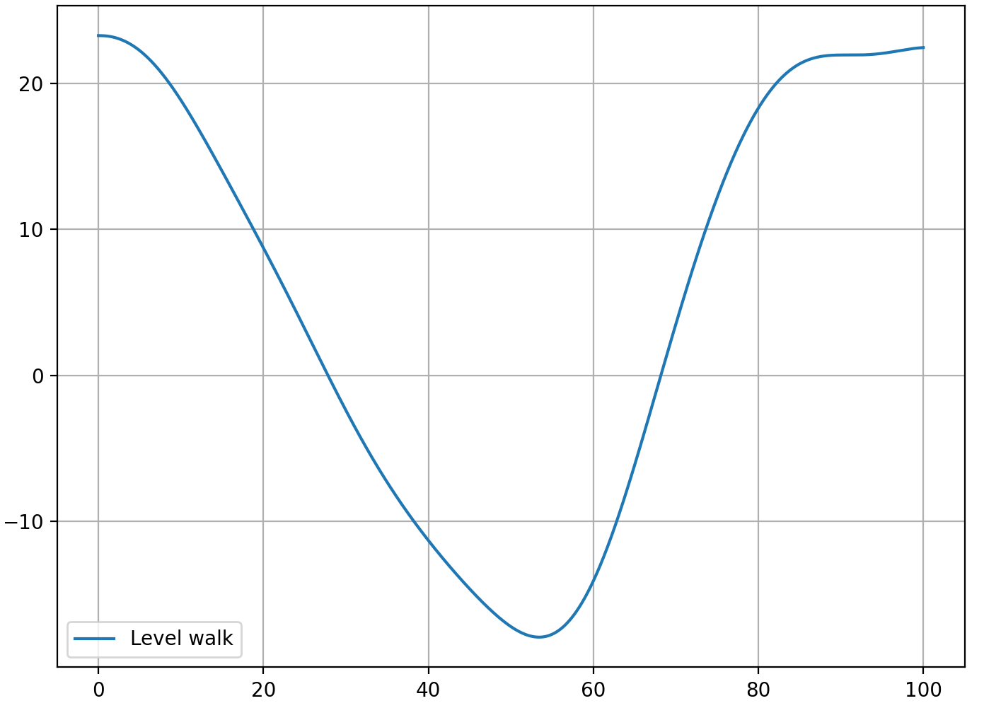
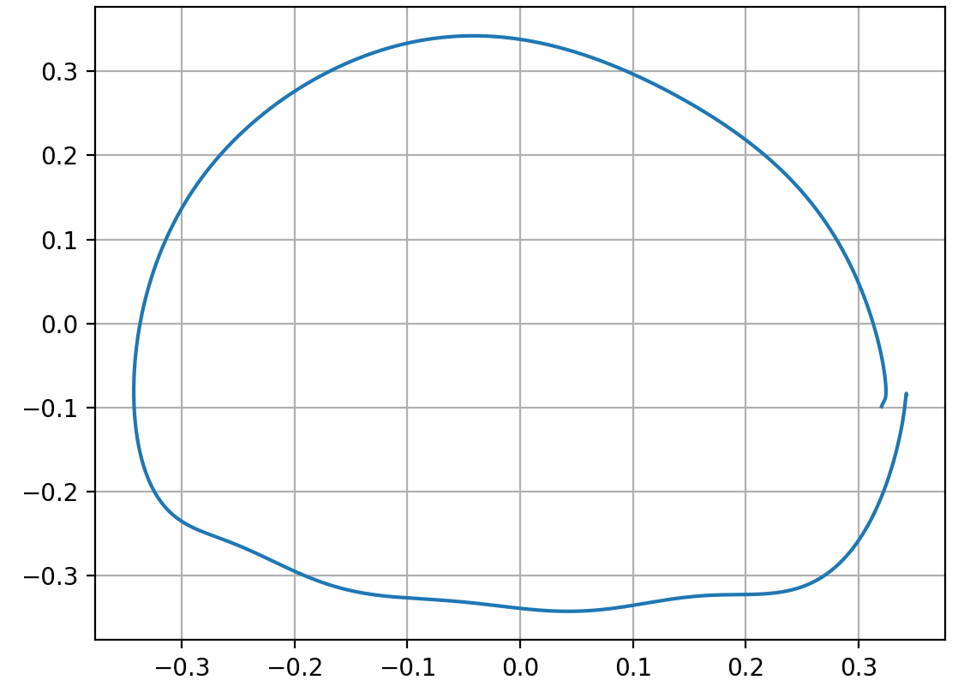
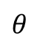
Introduction: Phase estimation for level walking
G
I
S
T
HUR
Group
03
Thigh angle
Phase portrait
$$θ$$
Thigh angle (degree)
Integral of thigh angle (rad)
Gait cycle (%)
Thigh angle (degree)

Slide 5
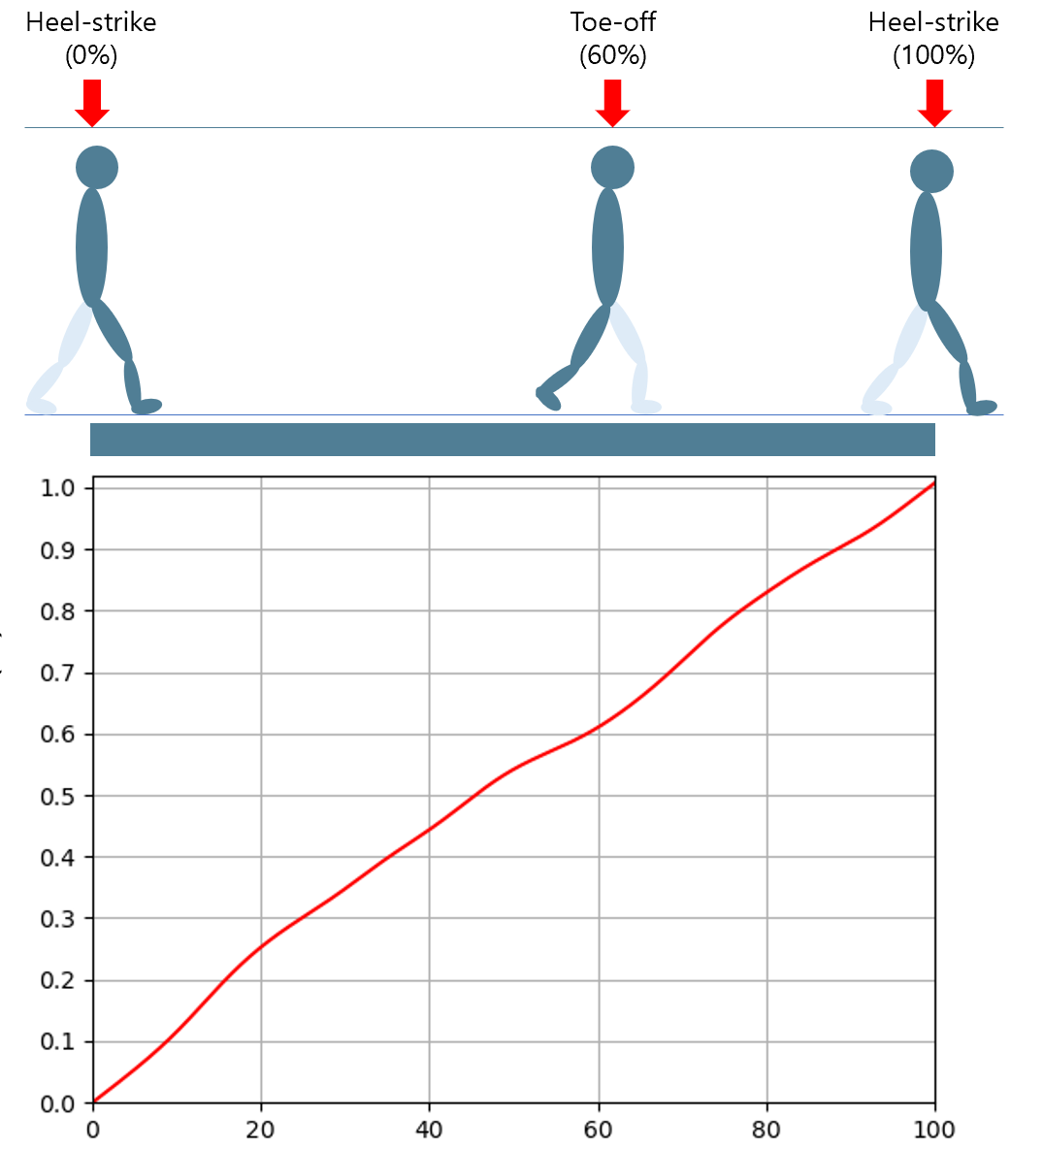
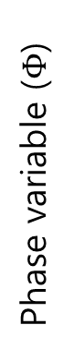
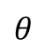
Introduction: Phase estimation for level walking
G
I
S
T
HUR
Group
04
Phase portrait
$$θ$$
Integral of thigh angle (rad)
Phase variable ($Φ$)
Monotonic
Linear
Thigh angle (degree)
Gait cycle (%)

Slide 6
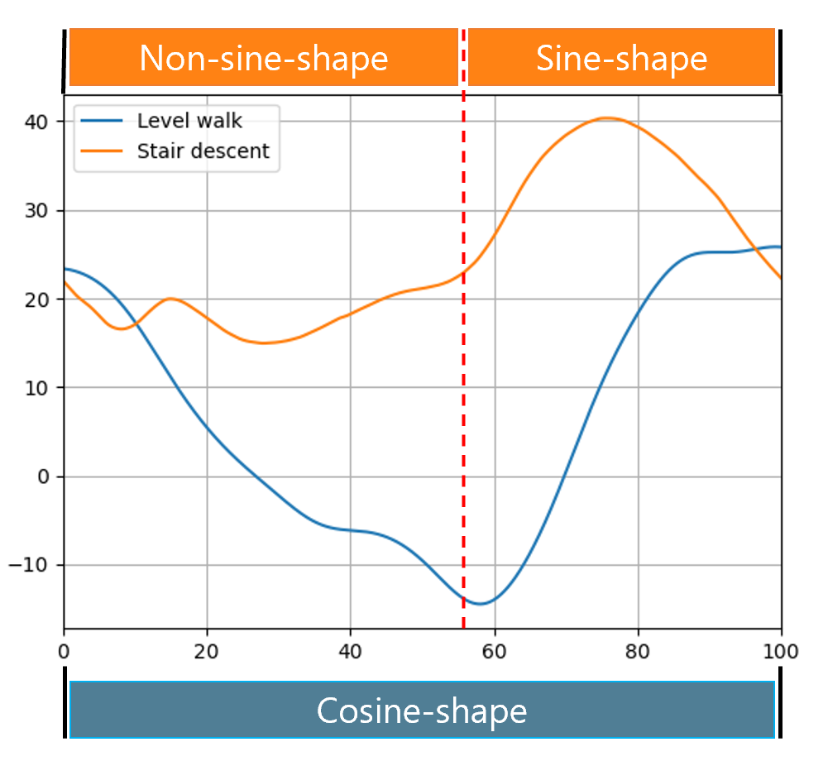
Introduction: problem
G
I
S
T
HUR
Group
05
Stair descent
There exists a part where the thigh angle of the stair descent shows the non-sine shape
Level walking
The thigh angle trajectory is a cosine-like function for the entire gait cycle for level walking

Slide 7
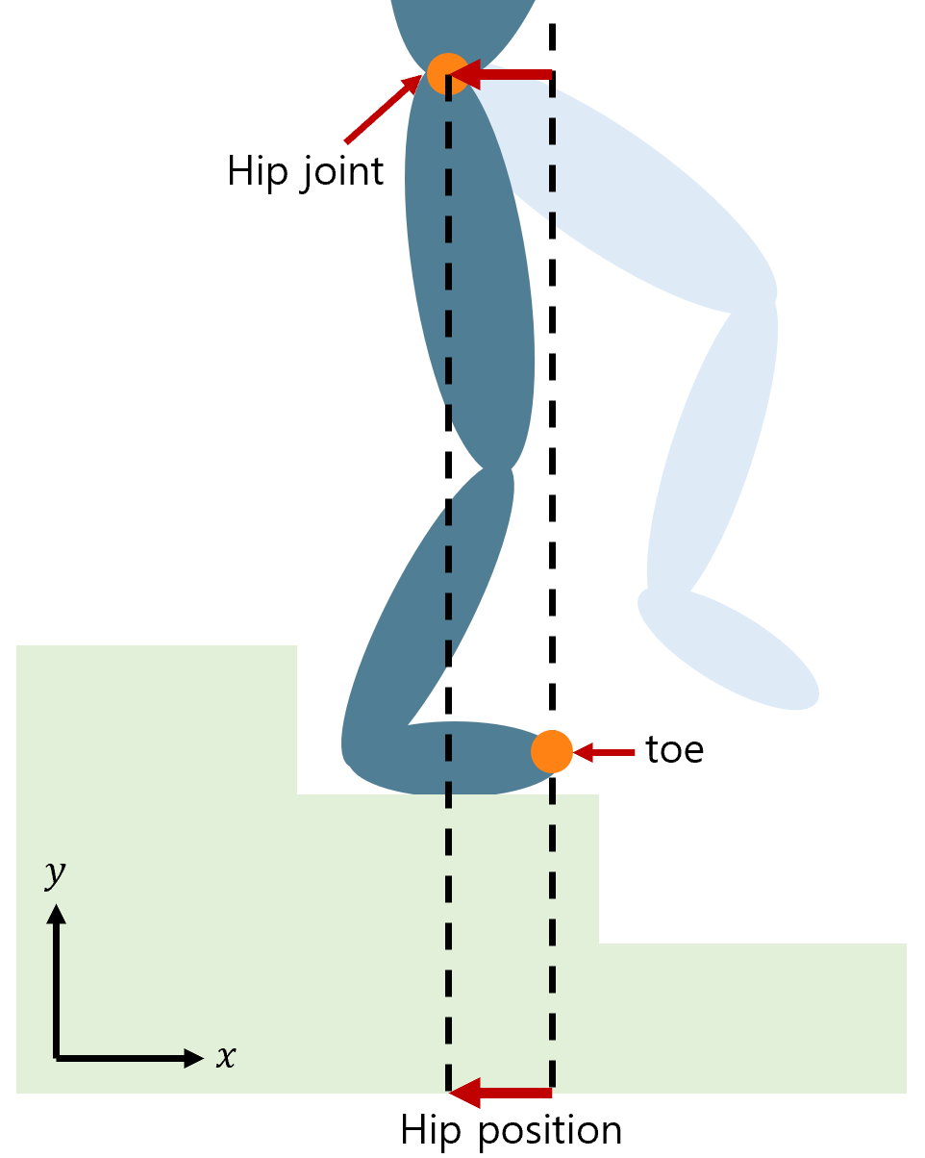
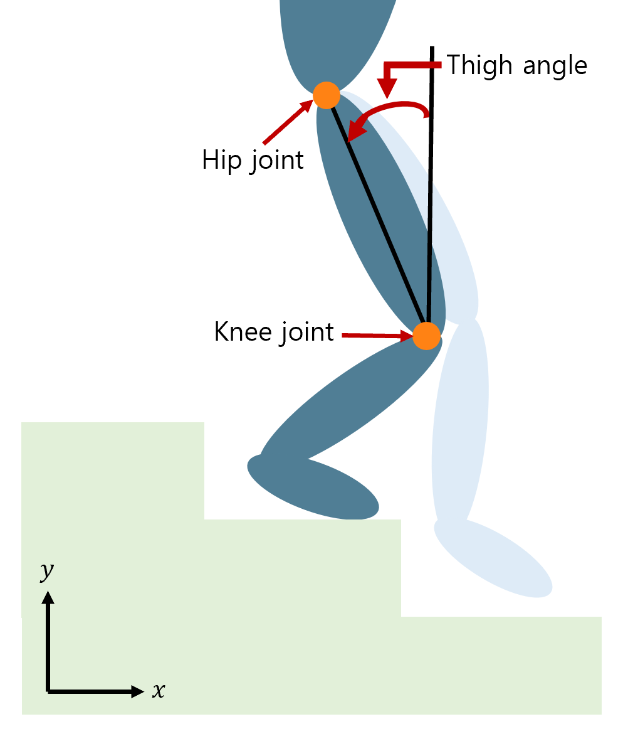
Methods: Phase variable candidates for stair descent
G
I
S
T
HUR
Group
06
Hip position
Thigh angle

Slide 8
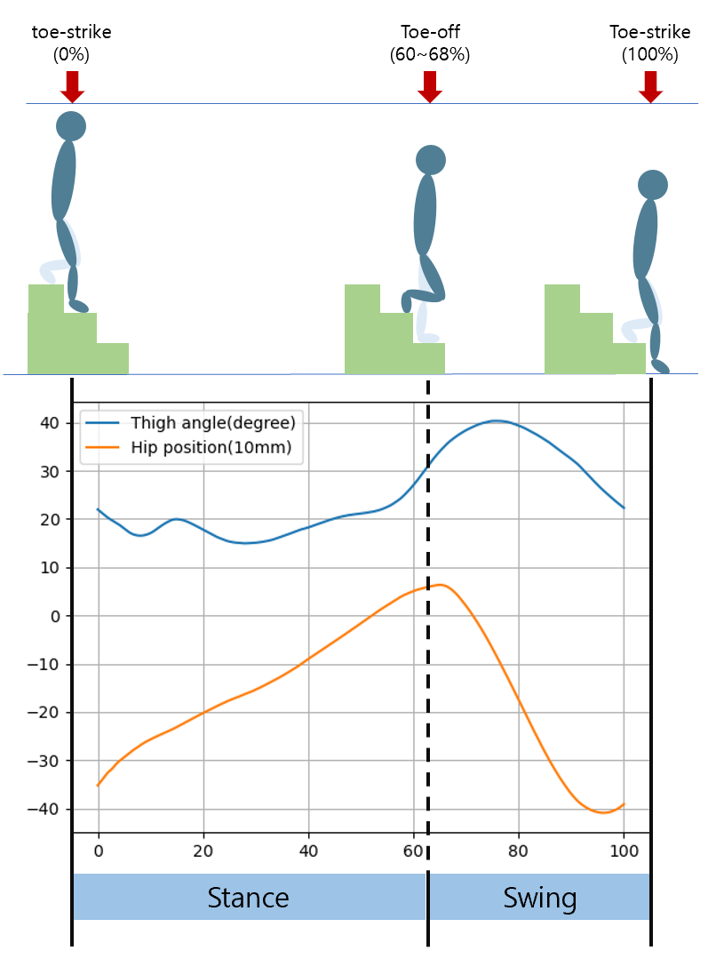
Methods: Phase variable candidates for stair descent
G
I
S
T
HUR
Group
07
Stance phase
Swing phase
Hip position
Thigh angle
Linear and monotonic
Sine-like function.
Calculate the phase variable using normalization.
Calculate the phase variable using phase portrait.

Slide 9
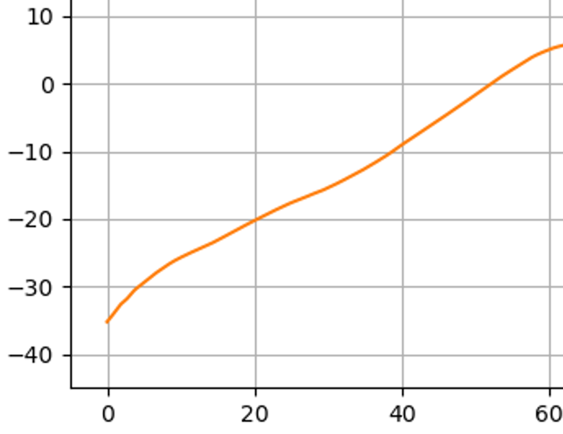
Methods: Phase variable calculation (stance phase)
G
I
S
T
HUR
Group
08
Hip position (10mm)
Linear and monotonic
Gait cycle (%)

Slide 10
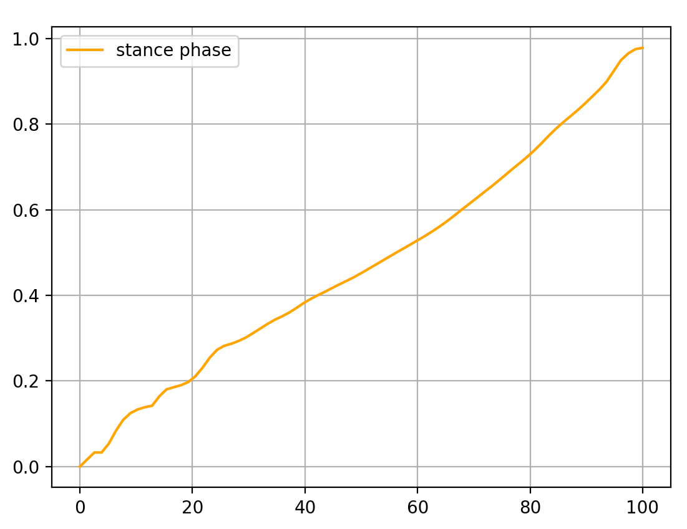
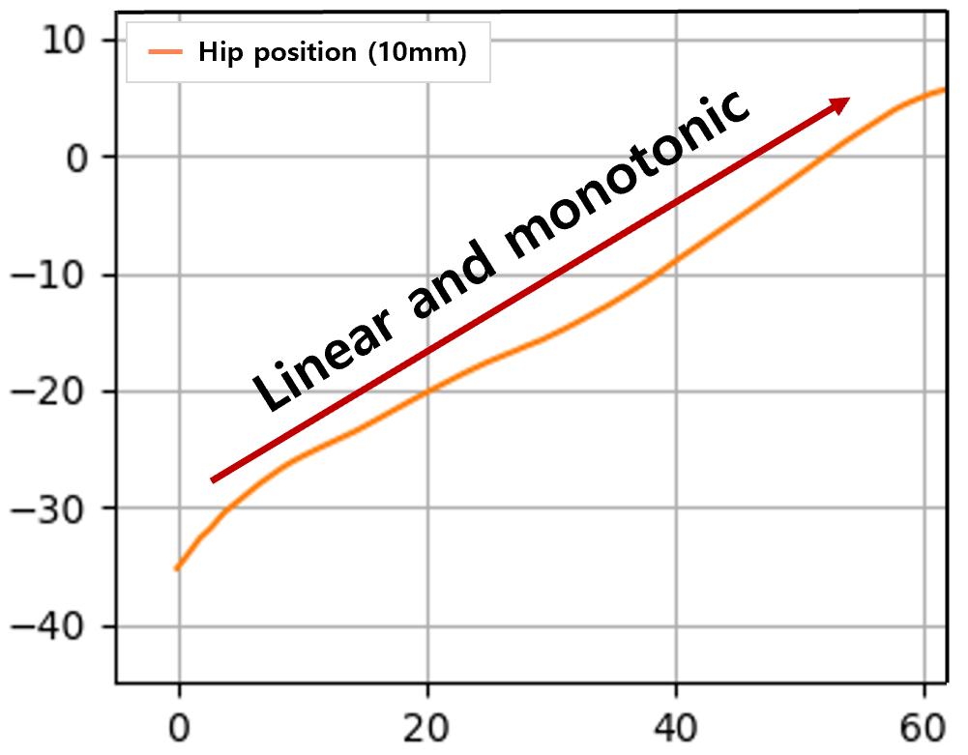
Methods: Phase variable calculation (stance phase)
G
I
S
T
HUR
Group
09
Normalization
Stance phase(%)

Slide 11
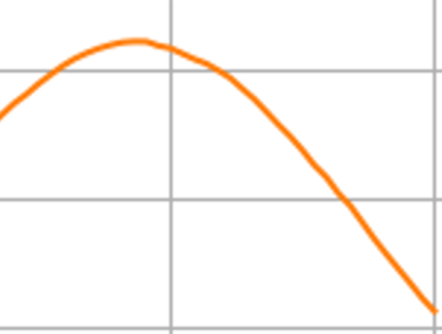
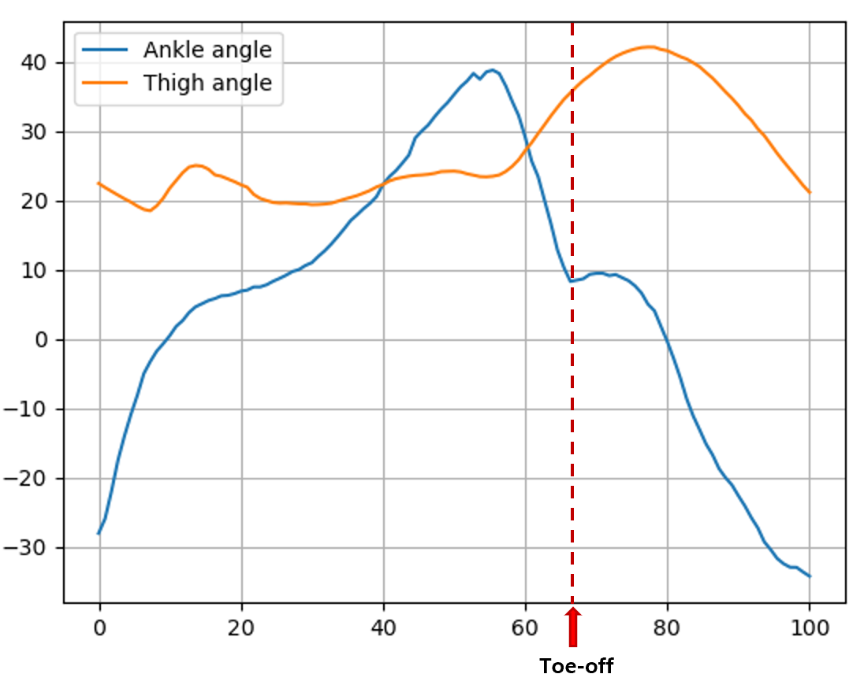
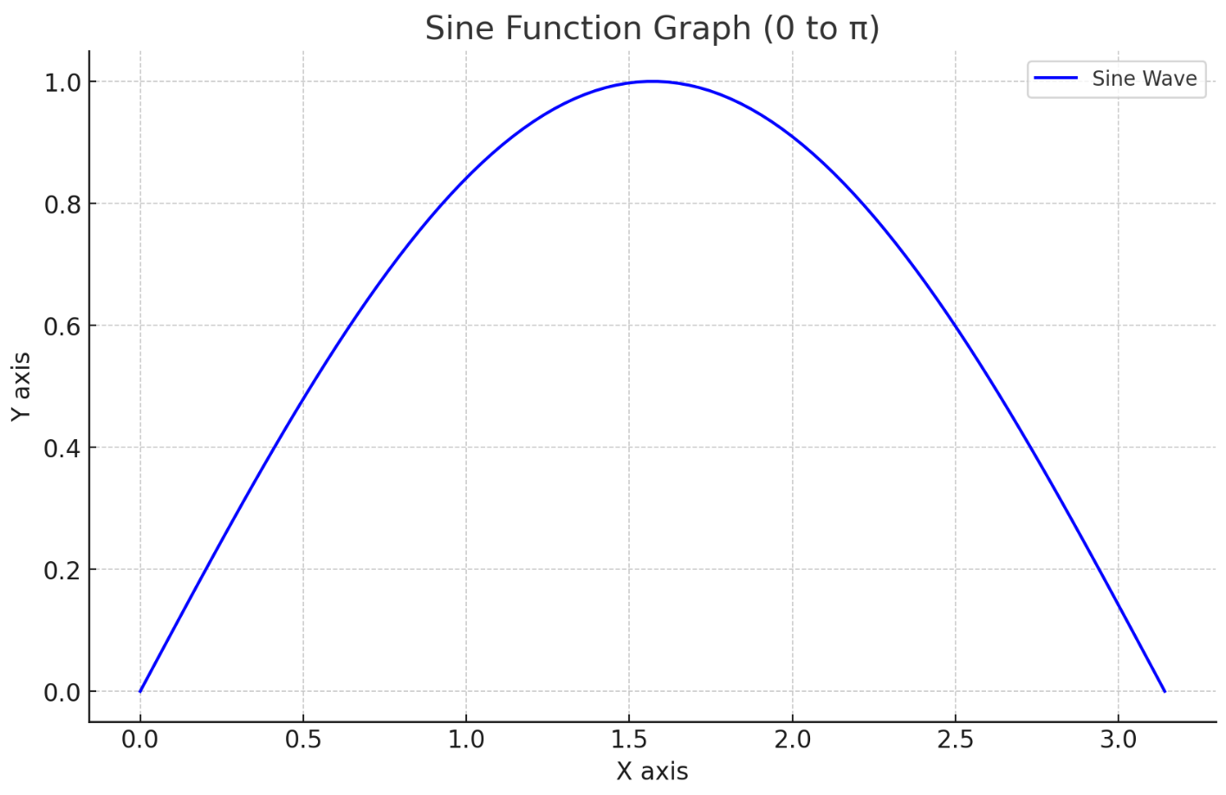
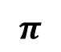
Methods: Phase variable calculation (swing phase)
G
I
S
T
HUR
Group
10
Angle (degree)
Sine
Gait cycle (%)
0
$$π$$

Slide 12
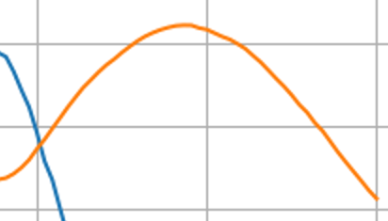
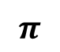
Methods: Phase variable calculation (swing phase)
G
I
S
T
HUR
Group
11
Ankle-peak
Angle (degree)
Sine
Gait cycle (%)
0
$$π$$

Slide 13
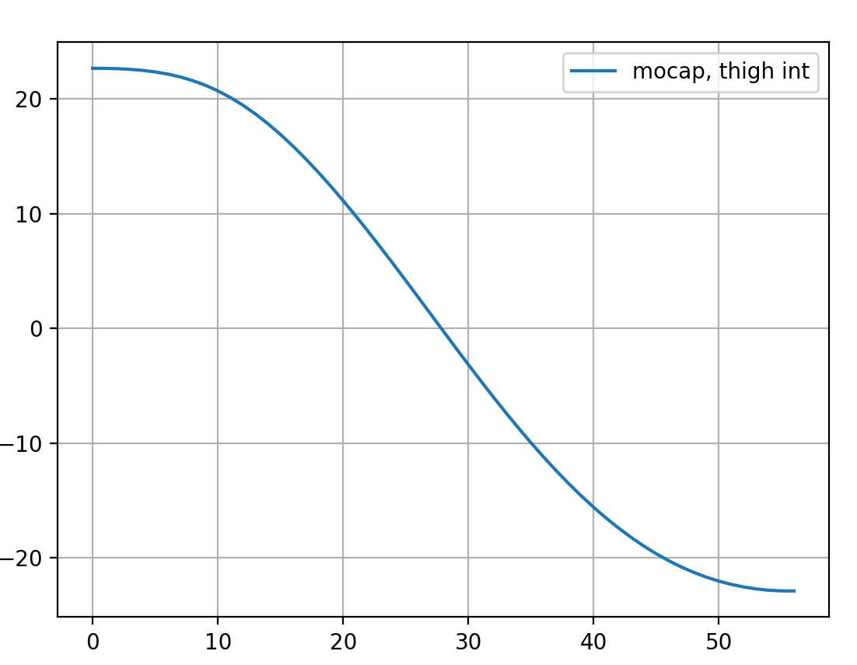
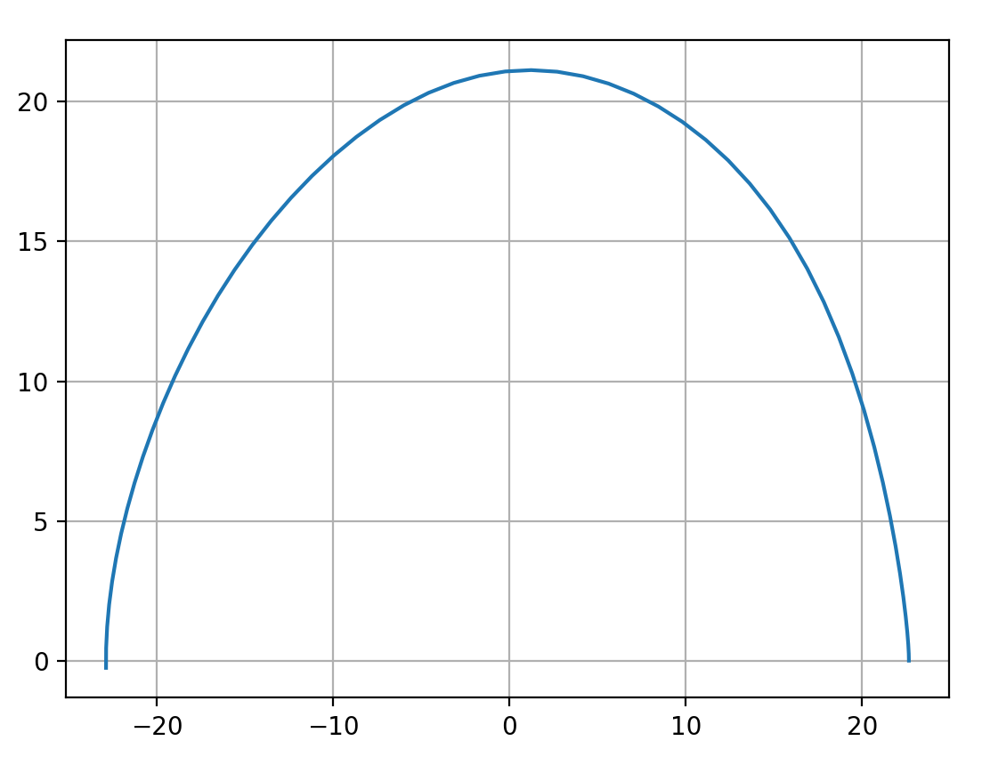
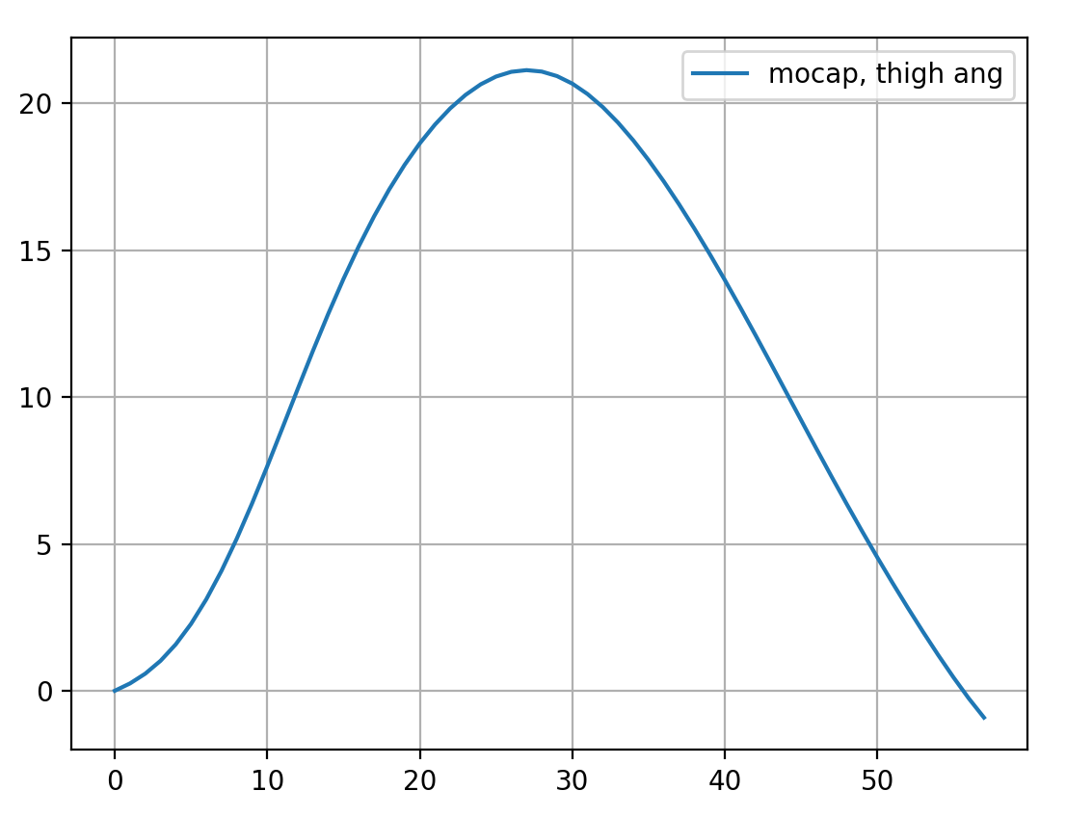

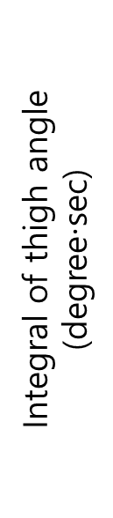
Methods: Phase variable calculation (swing phase)
G
I
S
T
HUR
Group
Integral of thigh angle (degree$⋅$sec)
12
Cosine
Time(0.01sec)
Thigh angle (degree)
Integral of thigh angle (degree$⋅$sec)
Thigh angle
(degree)
Sine
Time(0.01sec)

Slide 14
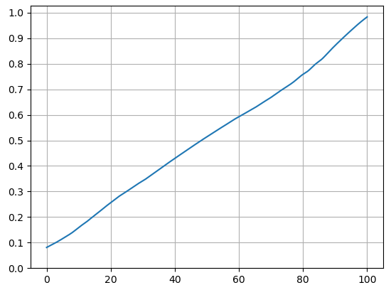
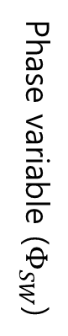
Methods: Phase variable calculation (swing phase)
G
I
S
T
HUR
Group
13
Temporary swing phase
Swing phase
Phase variable ($Φ_{SW}$)
Toe-off
Peak ankle moment
End of the gait

Slide 15
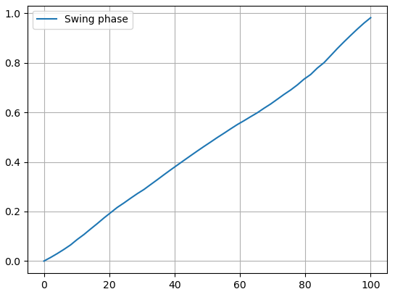
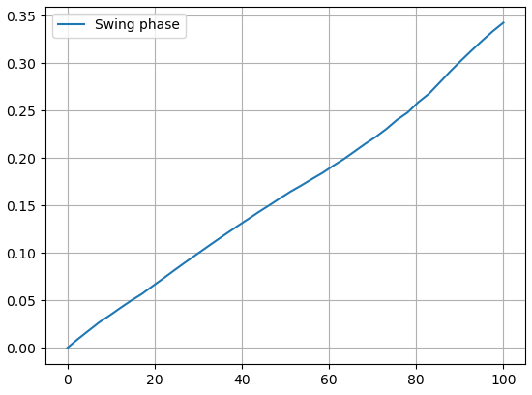
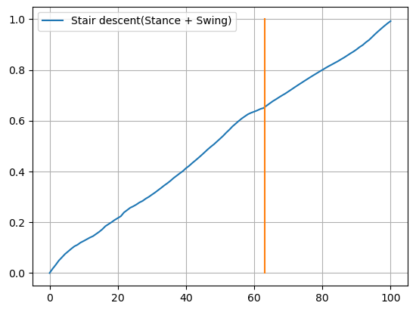
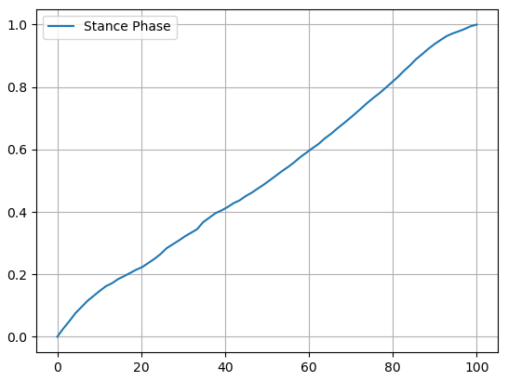
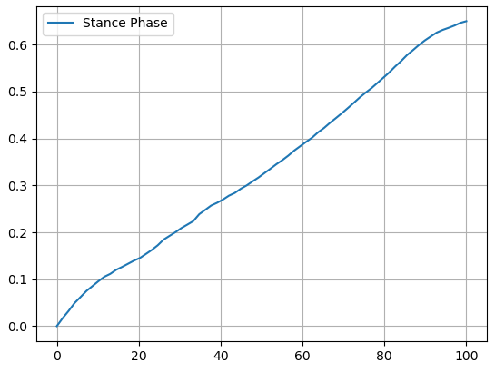
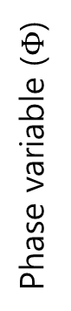
Methods: Phase variable calculation (one gait)
G
I
S
T
HUR
Group
14
1.0
0.35
Phase variable for entire gait
x0.35
0.0
0.0
Swing phase (%)
Swing phase (%)
Phase variable ($Φ$)
1.0
0.65
x0.65
Gait cycle (%)
0.0
0.0
Stance phase (%)
Stance phase (%)

Slide 16
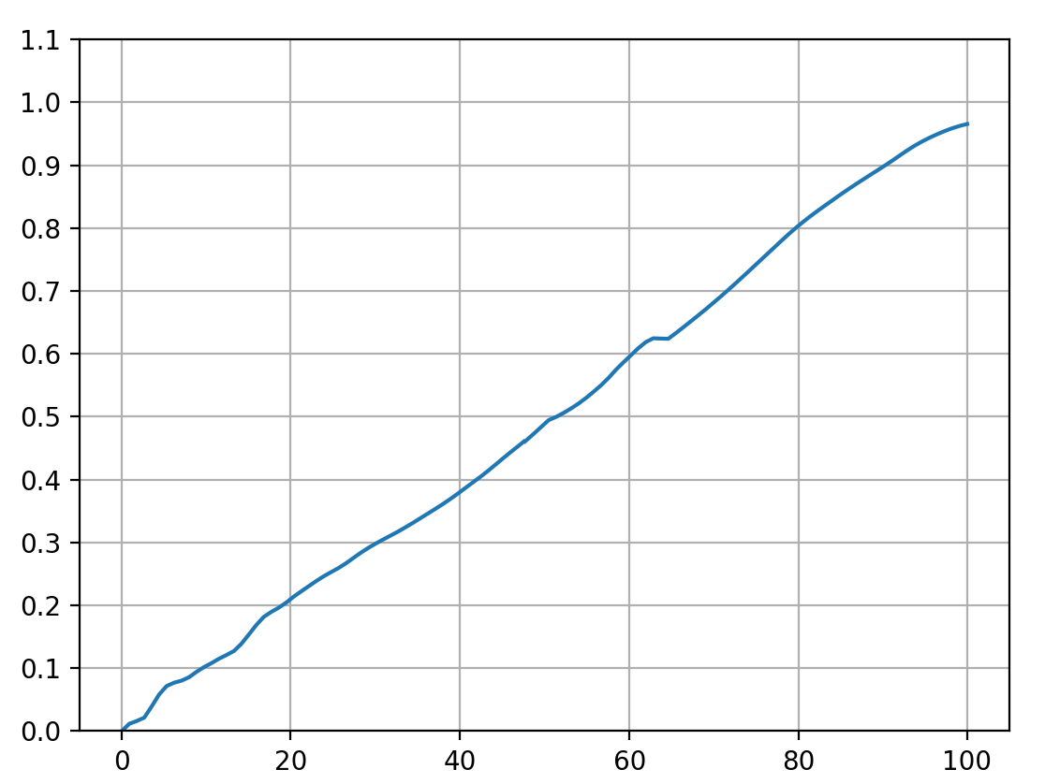
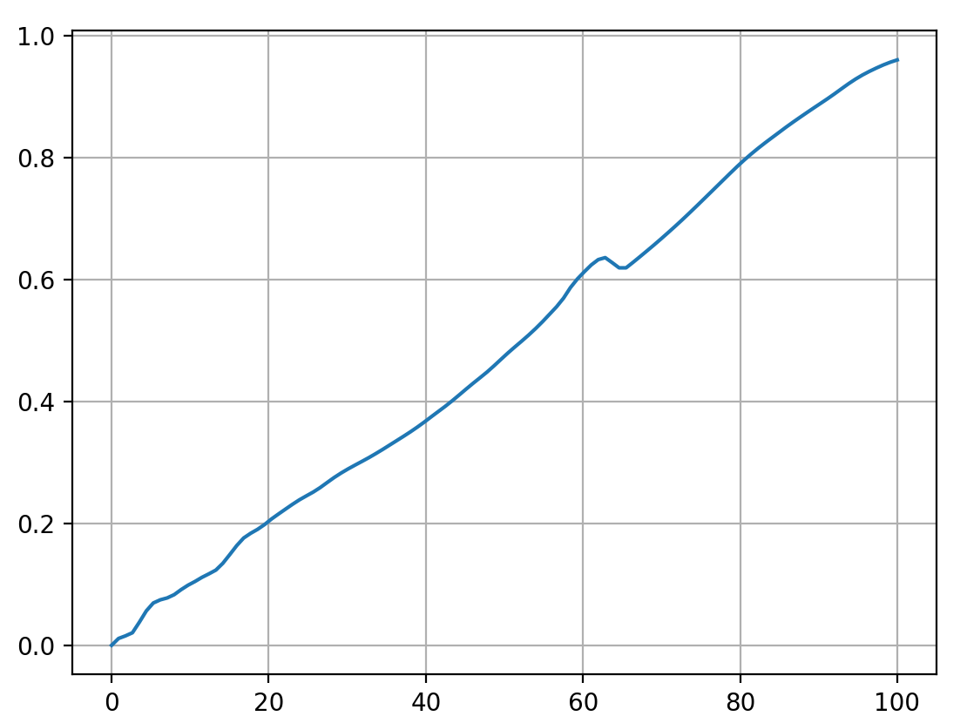
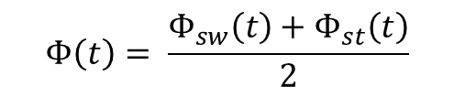
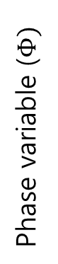

Methods: Phase variable calculation (blending)
G
I
S
T
HUR
Group
15
0.65
Blending
Phase variable for entire gait
$$Φ\left(t\right)= \frac{Φ_{sw}\left(t\right)+Φ_{st}\left(t\right)}{2}$$
$$t_{ankle peak}<t<t_{toe off}$$
0.0
Stance phase
Temporary swing phase
Phase variable ($Φ)$
0.35
Gait Cycle (%)
0.0
Gait cycle
0
1
Toe-off
Ankle-peak

Slide 17
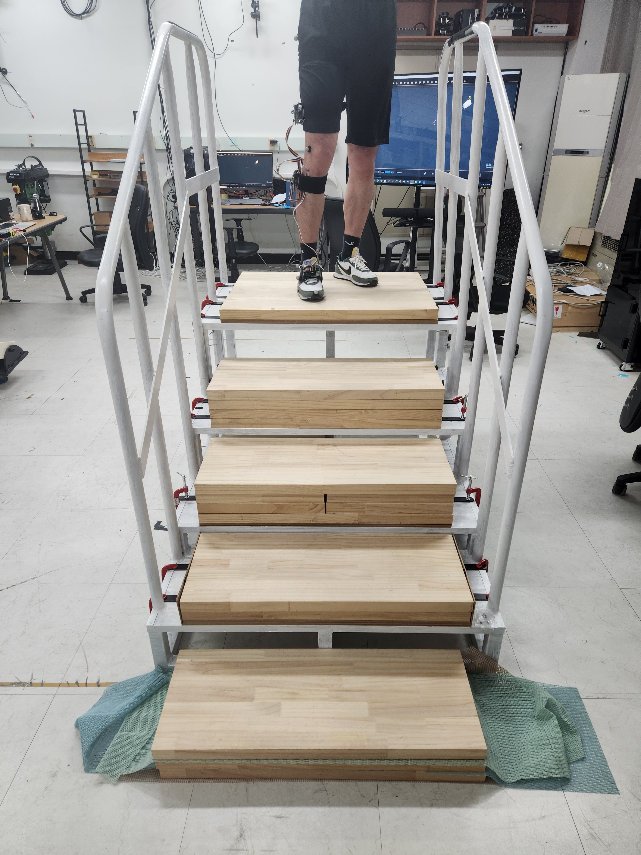
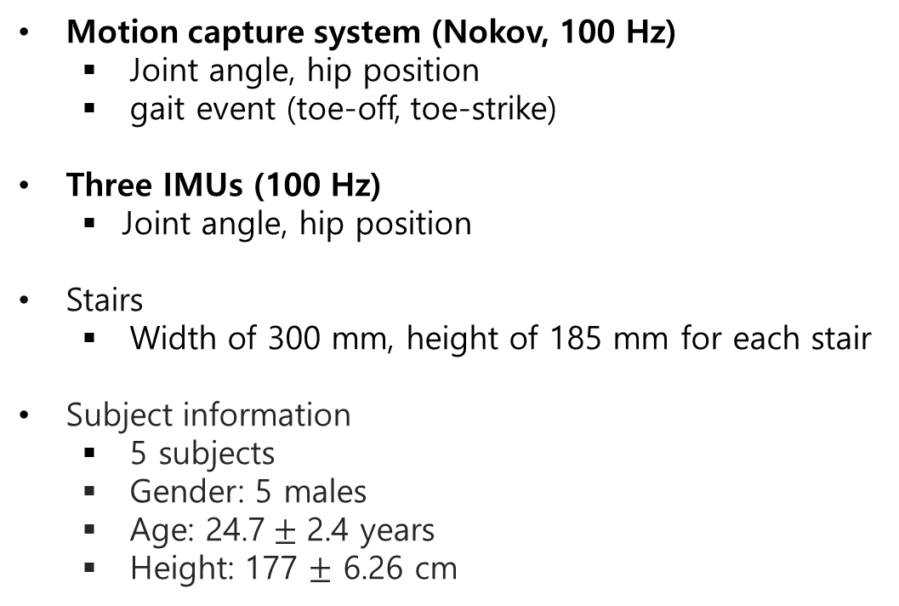
Experiment
G
I
S
T
HUR
Group
16
Motion capture system (Nokov, 100 Hz)
Joint angle, hip position
gait event (toe-off, toe-strike)
Three IMUs (100 Hz)
Joint angle, hip position
Stairs
Width of 300 mm, height of 185 mm for each stair
Subject information
5 subjects
Gender: 5 males
Age: 24.7$±$ 2.4 years
Height: 177 $±$ 6.26 cm

Slide 18
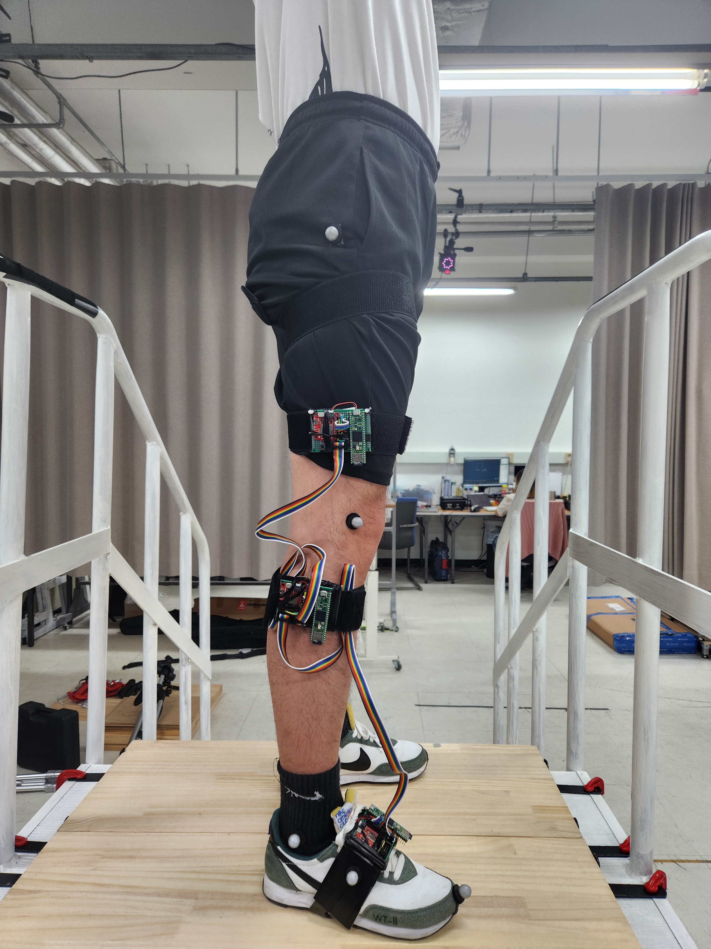
Experiment
G
I
S
T
HUR
Group
17
hip joint
knee joint
IMU
ankle joint
fifth metatarsal bone
Toe tip

Slide 19
Experiment
G
I
S
T
HUR
Group
18
Training session
The subjects walk down the stairs repeatedly for 5-minutes.
If the subject feels walking down the stairs is comfortable enough, training session terminates early.
Experiment session
Subject stands on the top of the stairs in a comfortable pose.
After the initiation sign, the subject starts to walk down the stairs, stepping his right foot forward first.
After the subject steps on the ground with his right foot, the subject finishes his walking.
1-3 is done 20 times repeatedly. If there is any issue with the subject, the experiment will be halted immediately.

Slide 20
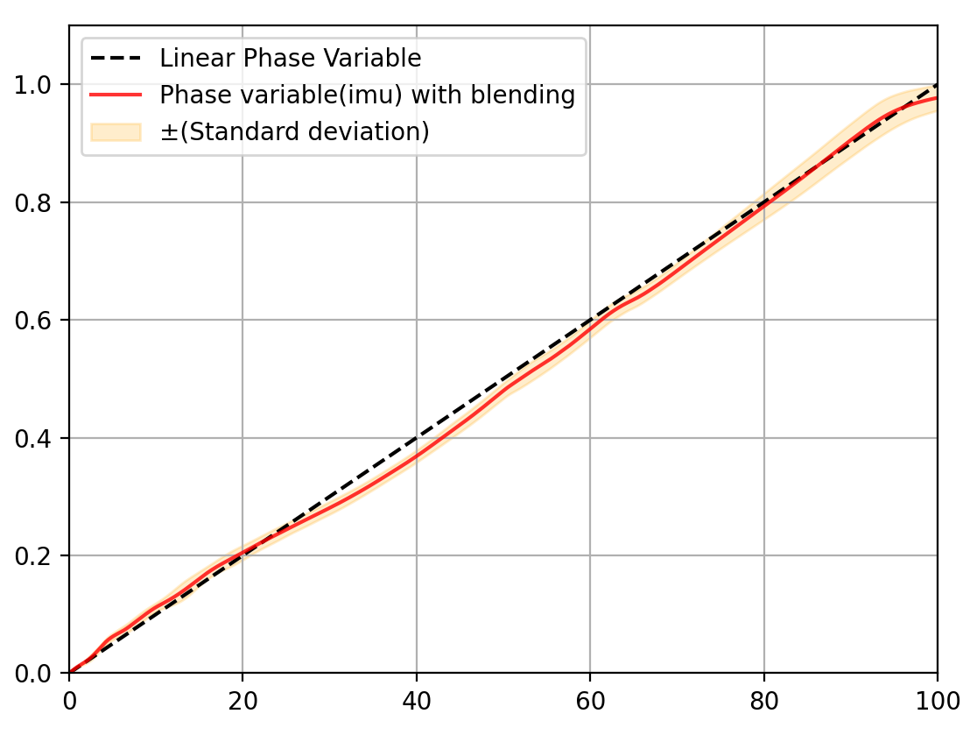
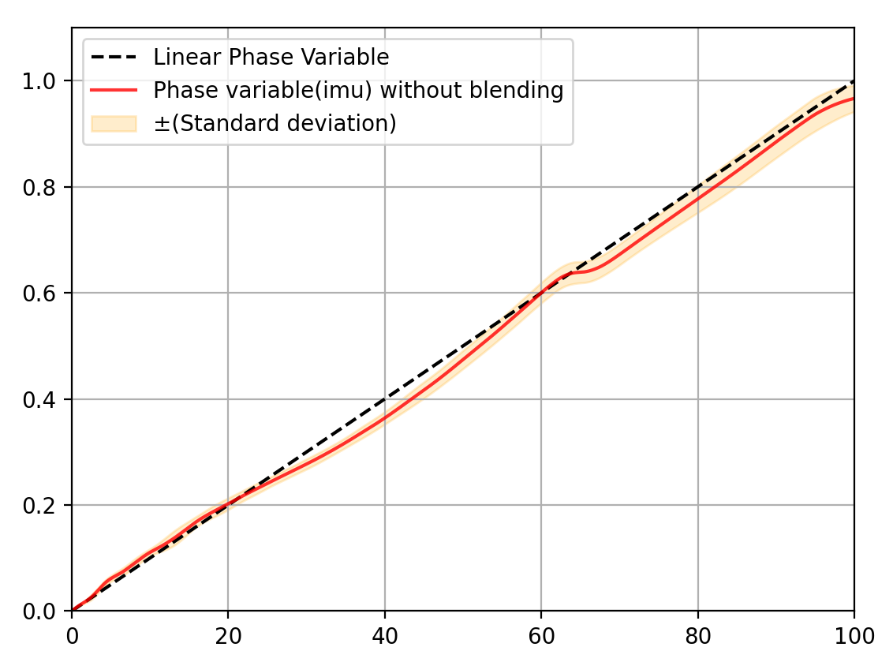
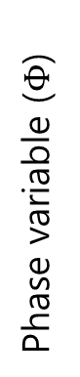

Result: Effect of blending
G
I
S
T
HUR
Group
19
Phase variable with blending (PV-WB)
Phase variable without blending (PV-WOB)
Phase variable ($Φ$)
Phase variable ($Φ$)
Gait phase (%)
Gait Phase (%)
Blending method smooth out the phase variable.

Slide 21
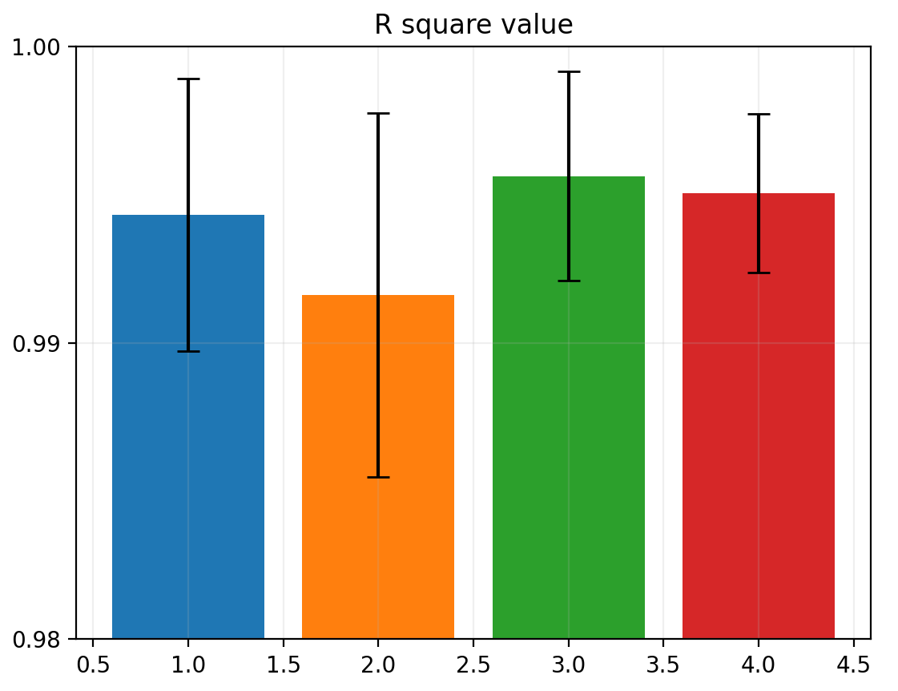
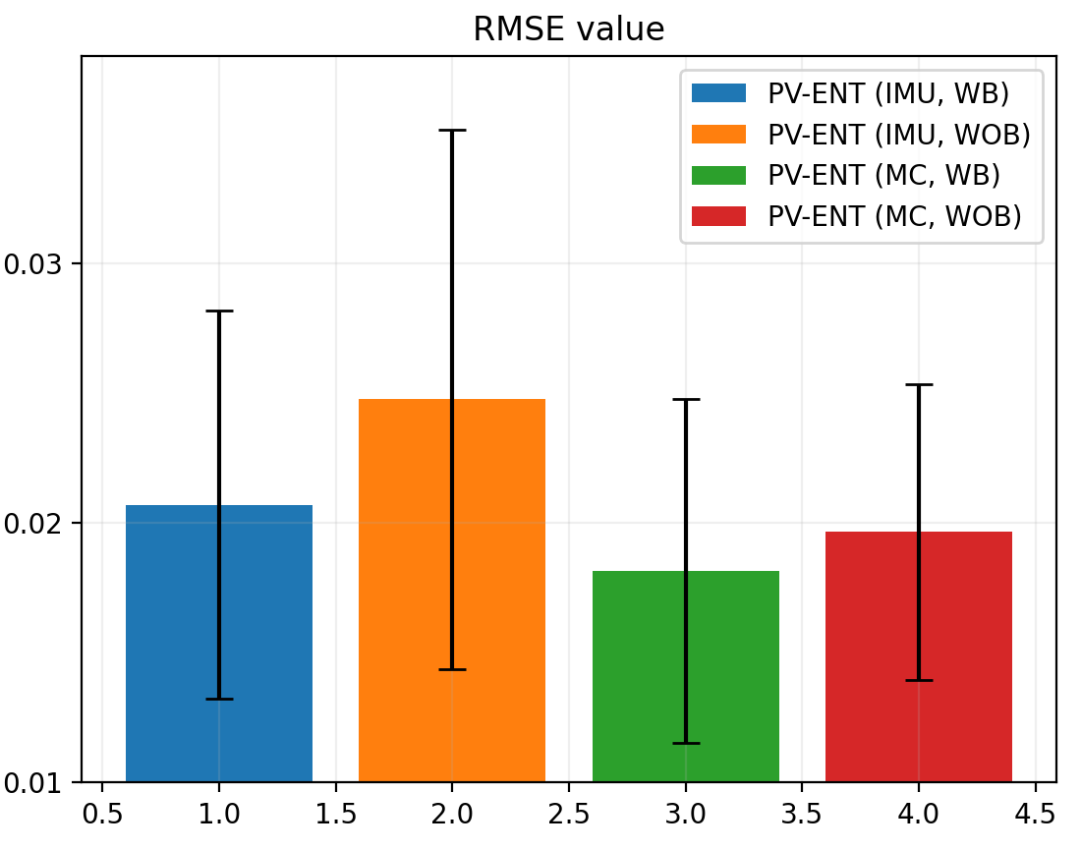
Result: Motion capture vs IMU / with blending vs without blending
G
I
S
T
HUR
Group
20
WOB
WB
WOB
WB
WB
WOB
WB
WOB
0.9943
0.9916
0.9956
0.9951
0.0207
0.0248
0.0182
0.0197
IMU
MC
IMU
MC
PV-ENT: phase variable for entire gait cycle, MC: motion capture, WB: with blending, WOB: without blending

Slide 22
Result: With blending vs without blending
G
I
S
T
HUR
Group
21
WOB
WB
WOB
Better
Better
WB
WB
WOB
WB
WOB
Better
Better
0.9943
0.9916
0.9956
0.9951
0.0207
0.0248
0.0182
0.0197
IMU
MC
IMU
MC
PV-ENT: phase variable for entire gait cycle, MC: motion capture, WB: with blending, WOB: without blending
Phase variable with blending showed better performance than without blending.

Slide 23
Result: Motion capture vs IMU
G
I
S
T
HUR
Group
22
Better
Better
WOB
WB
WOB
WB
WB
WOB
WB
WOB
0.9943
0.9916
0.9956
0.9951
0.0207
0.0248
0.0182
0.0197
IMU
MC
IMU
MC
PV-ENT: phase variable for entire gait cycle, MC: motion capture, WB: with blending, WOB: without blending
Phase variable using motion capture system showed better performance than IMU.

Slide 24
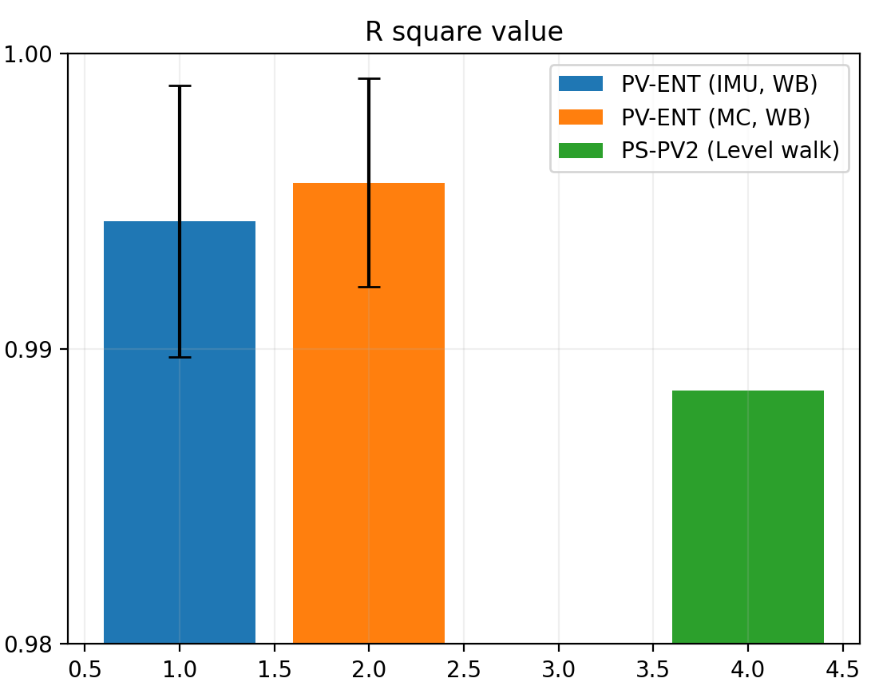
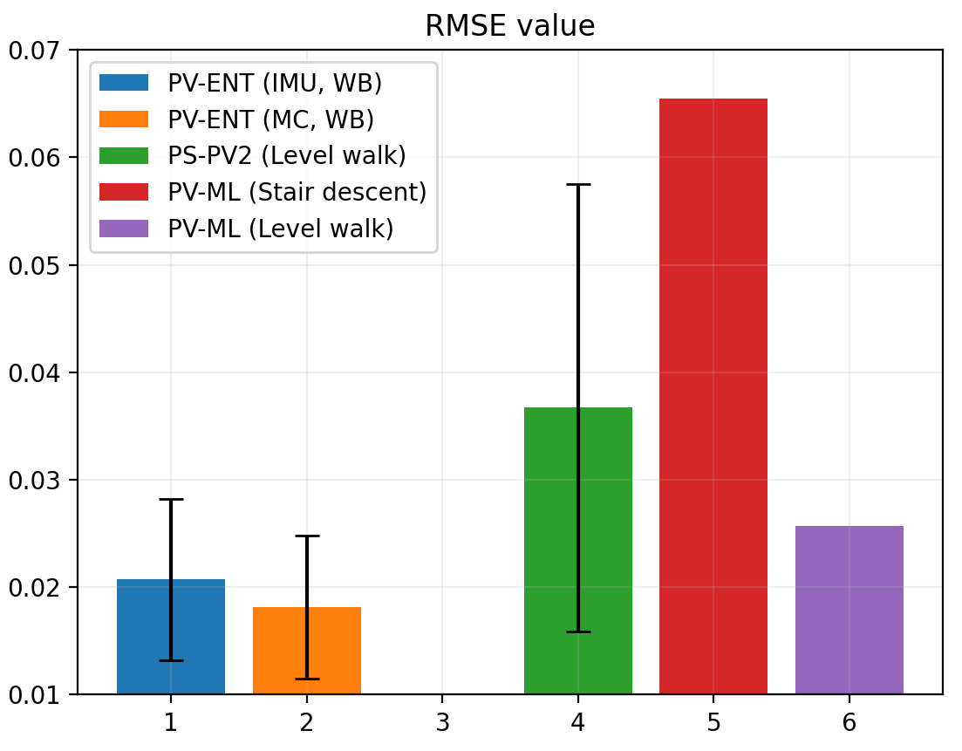
Result: Comparison with other studies
G
I
S
T
HUR
Group
23
Better
Better
IMU
MC
0.0207
0.0182
IMU
MC
0.9943
0.9956
0.9886
0.0367
0.0655
0.0257
PV-ENT
PS-PV2
PV-ENT
PS-PV2
PS-ML
PV-ENT: phase variable for entire gait cycle from this research, MC: motion capture, WB: with blending,
PS-PV2: phase variable from [1], PV-ML: phase variable from [2]
By comparing PV-ENT with the result of other research,
PV-ENT shows reliable phase estimation performance.

Slide 25
Conclusion and Future work
G
I
S
T
HUR
Group
24
Conclusion
A phase estimation method for stair descent is proposed with the lack of research in this area
Simple blending method can solve the smoothing problem from connecting different phases.
Phase variable using IMU data shows reliable performance.
Future work
The phase variable will be validated by implementing the phase variable to the prosthesis.
The effect of stair height on gait pattern will be examined.

Slide 26
Reference
G
I
S
T
HUR
Group
25
[1] Hong, Woolim, Namita Anil Kumar, and Pilwon Hur. "A phase-shifting based human gait phase estimation for powered transfemoral prostheses." IEEE Robotics and Automation Letters 6.3 (2021): 5113-5120.
[2] Kang, Inseung, et al. “Real-time gait phase estimation for robotic hip exoskeleton control during multimodal locomotion.” IEEE robotics and automation letters 6.2 (2021): 3491-3497

Slide 27

G
I
S
T
HUR
Group

